Slide 1

Car Price Prediction

Slide 2
Background of the problem
New cars cannot be afforded by most of the people due to various factors, so all these customers opt for a used car with best features due to which the demand for used cars is always increasing. To stay in the market competition we should always offer a best price which is best to both to customer and the owner. The model we are going to create would help us in identifying the price of the car based the parameters that we would be passing would help us tag a better price on the car.

Slide 3
Proposal
Using Machine learning algorithms, we will predict if car price of a used car.
Train the data with 80% of the dataset and test with the remaining 20% of the dataset.
Process Overview
Preliminary analysis on data
Data preparation and cleaning
Exploratory Data Analysis
Train and test models
Model evaluation and tuning

Slide 4
Data Understanding
The dataset that is selected has the features like mpg, mileage, year, enginesize etc.
It is a very large dataset with 72k records.

Slide 5
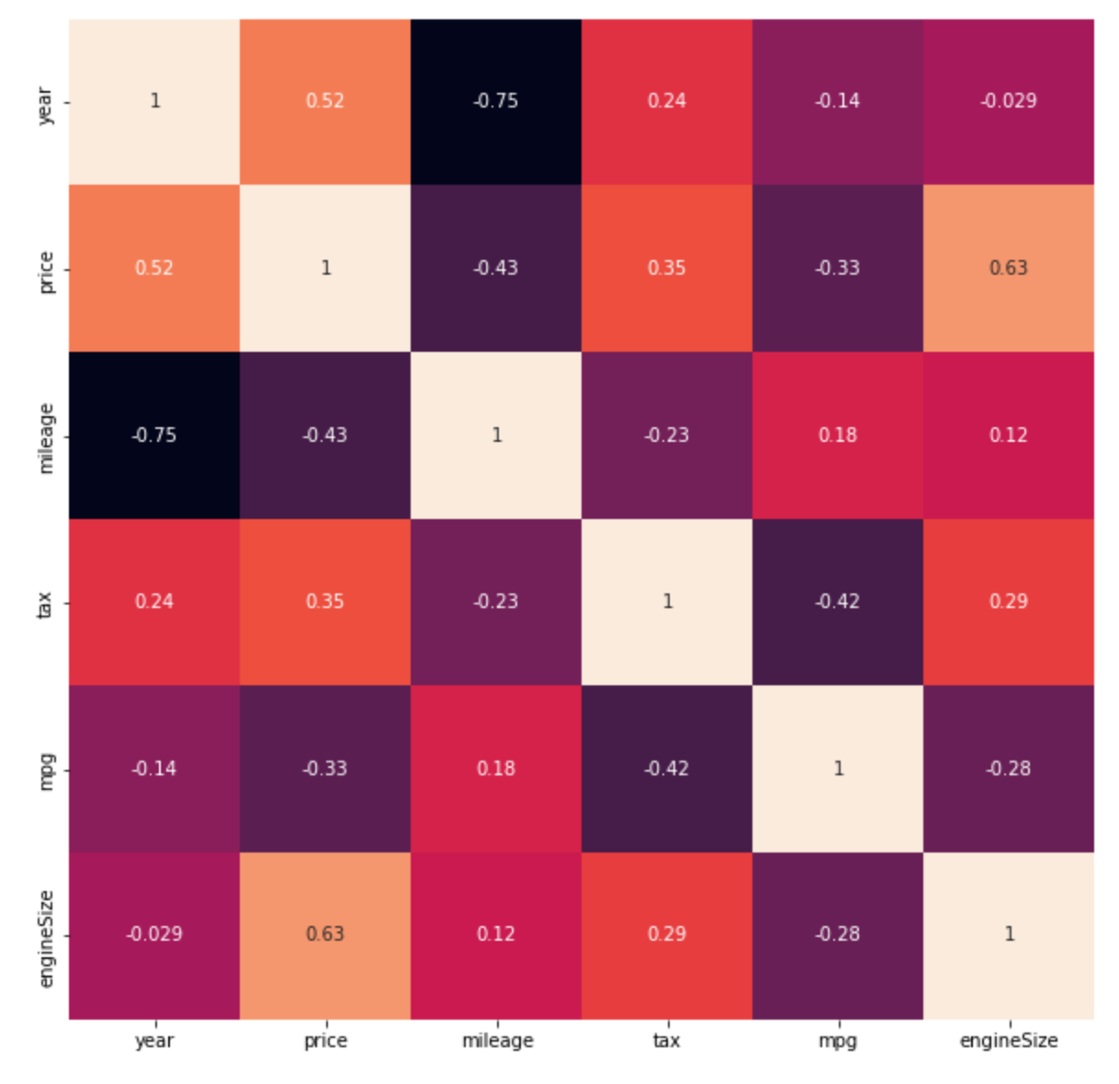
Exploratory Data Analysis
The matrix is used to find the correlation between all the possible pairs of values in the dataset.
In this matrix, mileage is negatively correlating with car price.
Mpg is positively correlating with any variables.

Slide 6
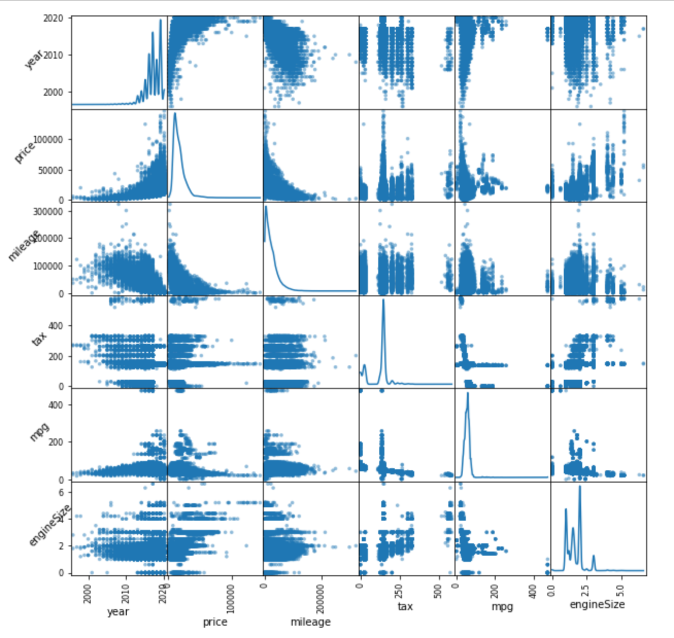
Scatterplot Relation of Variables
Most of the features are linearly dependent to the target variable price

Slide 7
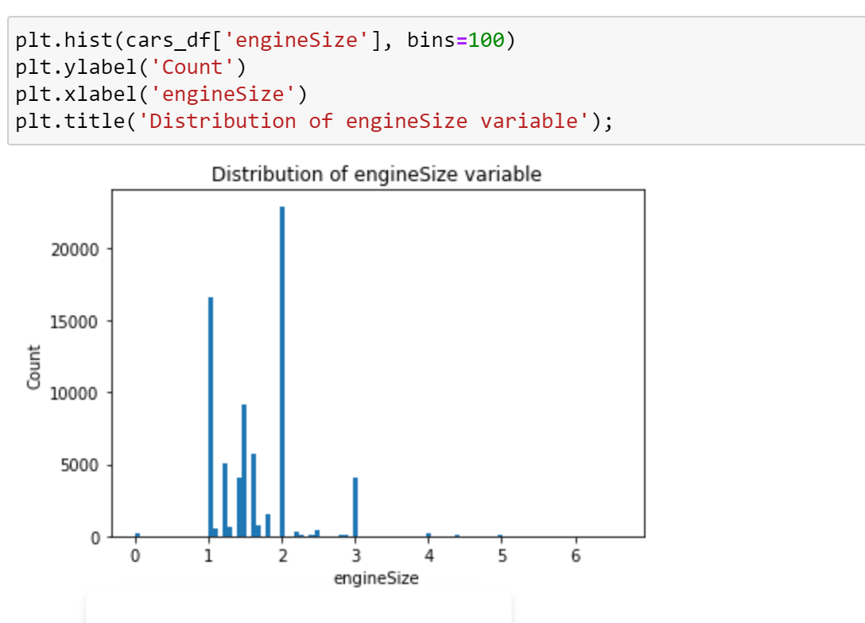
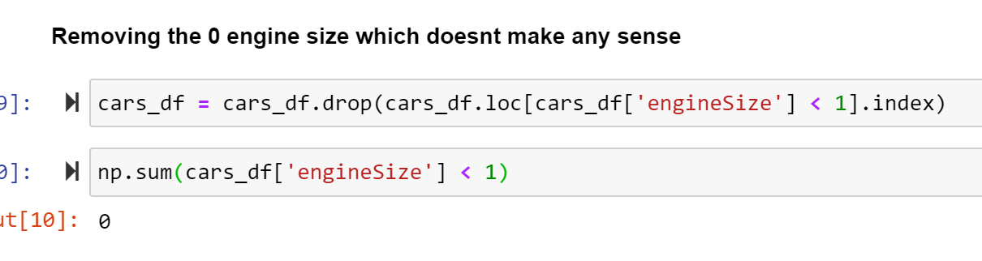
Handling Outliers
When we plot the Enginesize histograms, we can visually identify the outliers and remove them for the dataset.
In this we have removed the data where enginsesize is 0 which doenst make any sense

Slide 8
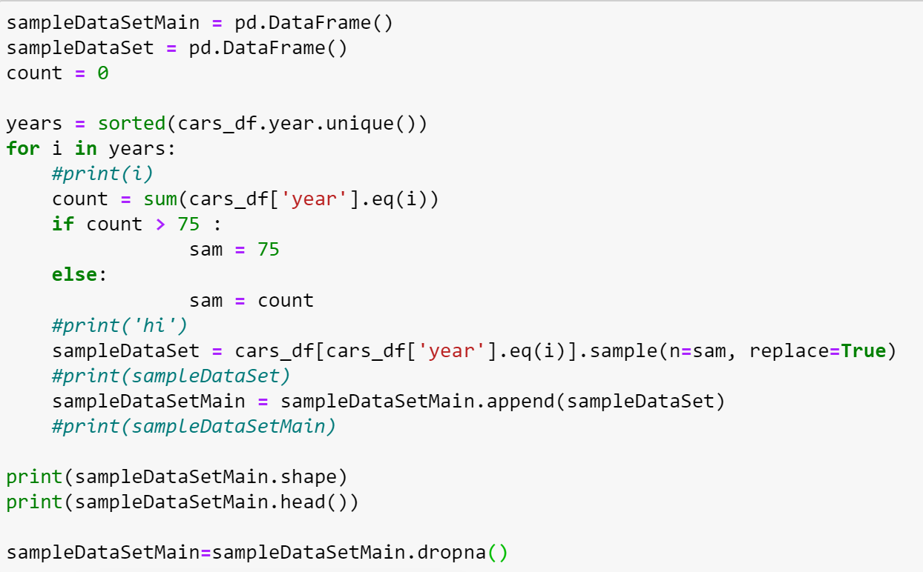
Extracting Sample Data
Since the data is huge, we have the extracted the random data from the data based on the year.
If the count of data is greater than the random sample number of 75 per year we are storing the data into a new data set

Slide 9
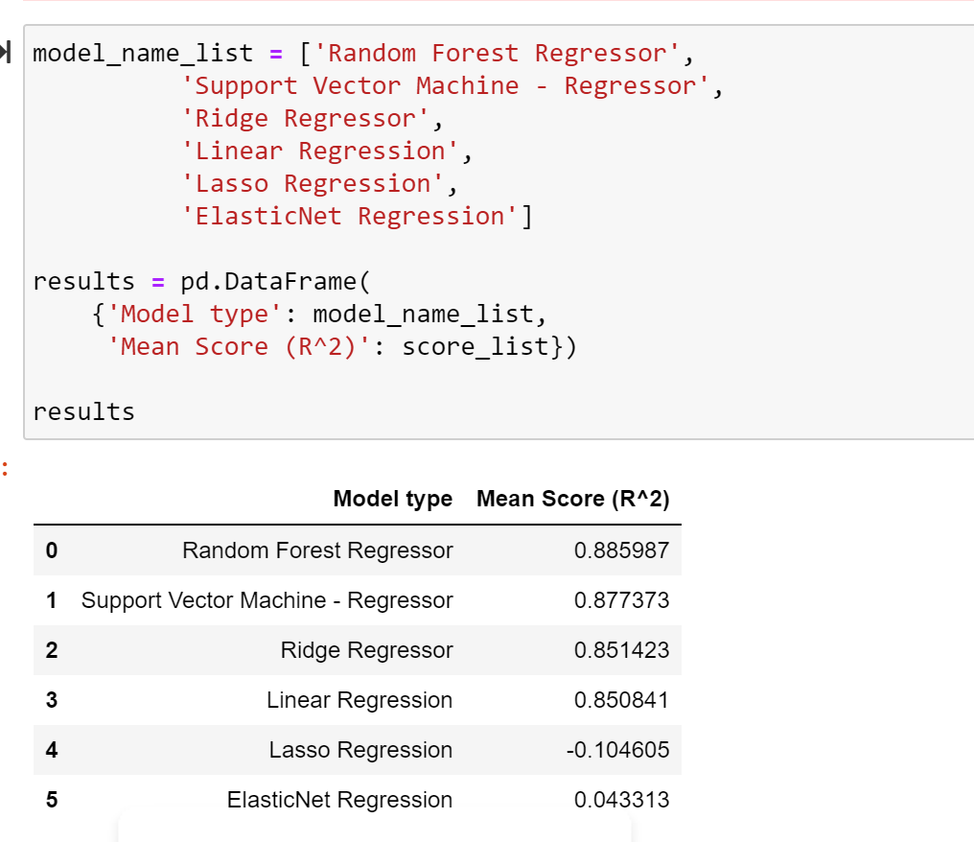
Model Selection
Based on a high model score value, between all the models we are using Random Forest Regressor Model to provides us high true prediction values for our dataset.

Slide 10
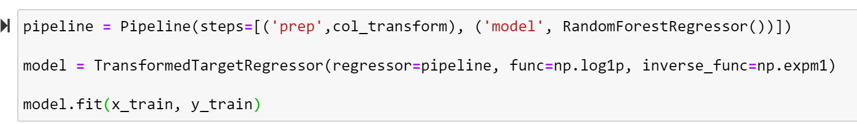
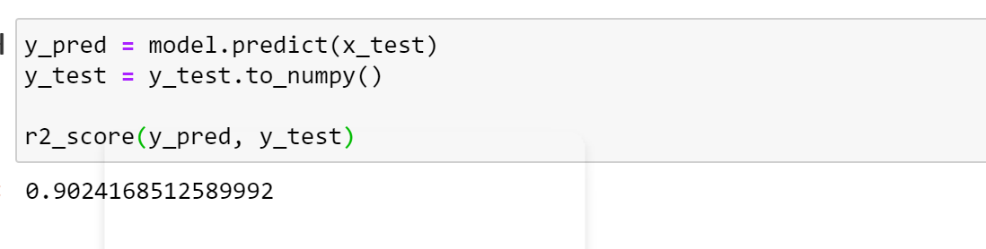
Build Model
By using the Random Forest Regressor we can see the accuracy of the model is 90.24% which is very good to predict the car price.

Slide 11
Conclusion
Old cars and More Mileage reduces the cost of car.
Based on a comparison of the Regression models, we recommend that Random forest Regression model would be a better performing model to predict the Car price.
Based on the Car price, Customer can decide whether to buy a car or not.

Slide 12
Reference
Kaggle link for a dataset: https://www.kaggle.com/aishwaryamuthukumar/cars-dataset-audi-bmw-ford-hyundai-skoda-vw
https://www.scribbr.com/methodology/research-ethics/
https://www.carmax.com/
https://www.carvana.com/

